Slide 1

Imperial college of engineering, Khulna Ru affiliated
PRESENTATION ON COMPUTER OUTPUT DEVICE

Slide 2
Presented by:
Afrin Mamun Sreety
Student ID: 23114
Season : 2023-2024
Submitted to:
Aparna Haldar
Department Head,
Department of Computer Science &
Engineering.
Imperial College of Engineering, Khulna
AND,
Arifa Akter Chondona
Student ID: 23154
Season: 2023-2024

Slide 3

To Our PRESENTATION
PRESENTATION

Slide 4


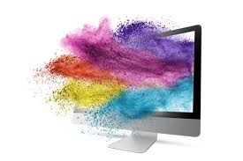
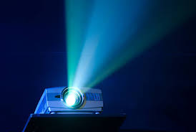
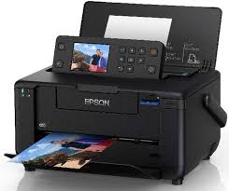
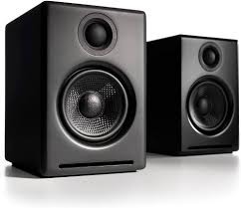


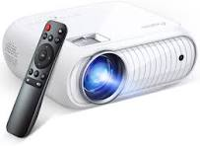
Over view
Introduction
Motivation
Computer Monitor
Speaker
Printer
Projector

Slide 5
INTRODUCTION OF OUTPUT DEVICE
Output device:
The output devices are those devices through which we get results or information on the computer.
For Example:
Monitor
Printer
Speaker
Projector

Slide 6
Motivation
I chose this topic to showcase the importance of output devices in making computer data understandable to us. They are essential for converting digital information into visual, audio, or physical forms, helping us better interact with technology.

Slide 7

Monitor
Monitor also known as a Visual Display Unit (VDU). The monitor is provides along with computer to view the display result.
A monitor is of two types.

Slide 8
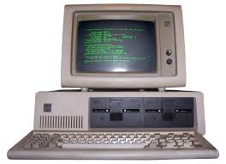
Mono chrome display monitor: Mono Chrome display monitor uses only one color to display text.
Color display monitor: Color display monitor display 256 color at a time

Slide 9
printer
Printer is most important output device which is used to print the information on the paper.
Printer is of two types.

Slide 10
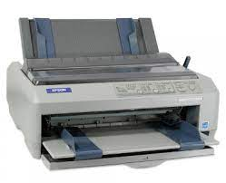
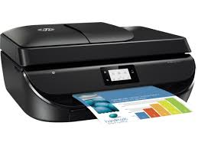
Impact printer: The printer that print the character by striking against the ribbon and on to the paper are called impact printer.
Non-impact printer: A printer that print the character without striking against the ribbon and on the paper are called non-impact printer. These printer print a compete page at s time.

Slide 11
Speaker
Speaker also is an output device. That receive sound in from of electric current.

Slide 12
Projector
A projector is an optical device that takes images or video from a source (like a computer, DVD player, or USB drive) and displays it on a larger screen or wall by using a lens system and light source.
A projector is of four types.

Slide 13
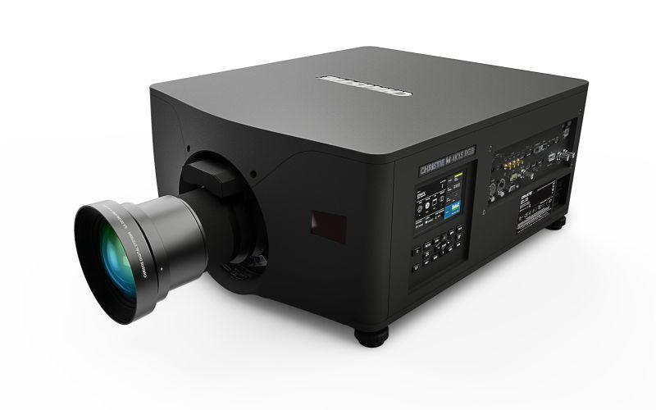
LCD (Liquid Crystal Display) Projectors: Use liquid crystal panels to allow light through in specific colors and intensities, producing the image by combining red, green, and blue light.
DLP (Digital Light Processing) Projectors: Use tiny mirrors to reflect light through a spinning color wheel, generating an image with vibrant colors and high contrast.

Slide 14
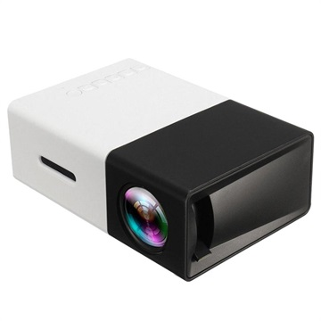
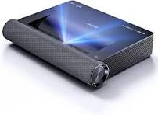
LED Projectors: Use LED lights as the light source, which are energy-efficient and have a longer lifespan compared to traditional lamps.
Laser Projectors: Use lasers for illumination, providing bright, high-contrast images that work well even in lit environments.

Slide 15

Thank You

